Slide 1
Tri Nguyen
Terry Lin
Mohamed Ismail
Wesley Li
Elise Nguyen
Exploratory Data Analysis of Political Donations

Slide 2
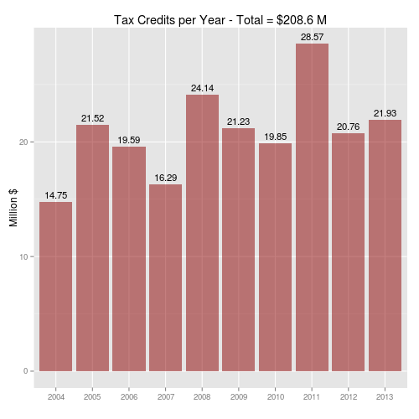
Tax Credits
How much public money pumped into the system each year ?

Slide 3
Regional Variation
What’s the highest donating city/province ?

Slide 4
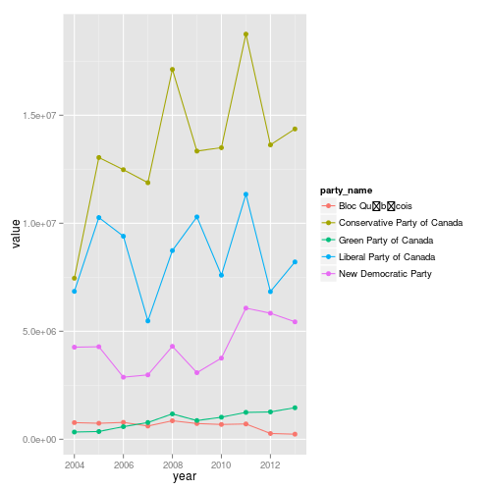
Party Differences
What are each party’s trends ?

Slide 5
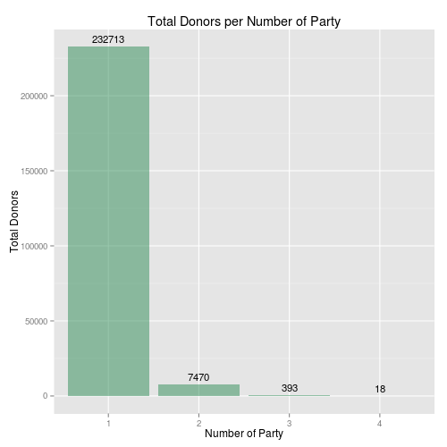
Party Differences
How many people donate to multiple parties ?

Slide 6
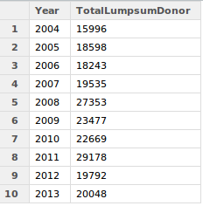
Frequency
How many people donate one lump sum every year ?

Slide 7
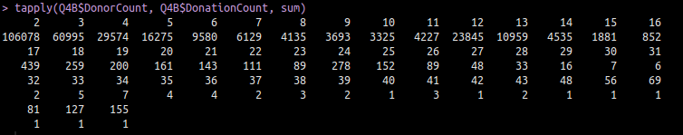
Frequency
How many donate every month ?

Slide 8
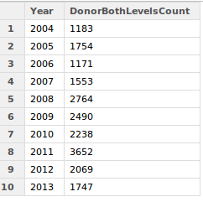
Structure
How many people donating at both levels ?

Slide 9
Structure
Number of donors inside and outside of the riding ?
163,644

